Slide 1


Kevin Holstein
<fill in date when done>

Slide 2

Outline
Executive Summary
Introduction
Methodology
Results
Conclusion
Appendix

Slide 3
Executive Summary
In this project we will predict if SpaceX Falcon 9 first stage will land successfully using machine learning classification algorithms as some features of the rocket launches have a correlation with the outcome of the launches that would be hard for a human to calculate. Such as Payload mass, Orbit type, Launch site, etc.
The data tree classification algorithm may be the best machine learning algorithm to predict if the Falcon 9 first stage will land successfully.

Slide 4
Introduction
SpaceX advertises Falcon 9 rocket launches on its website with a cost of 62 million dollars; other providers cost upward of 165 million dollars each, much of the savings is because SpaceX can reuse the first stage. If we can determine if the first stage will land, we can determine the cost of a launch and how much we save against competitors.

Slide 5

Section 1

Slide 6
Methodology
The overall methodology includes:
Data collecting, wrangling and formatting from the SpaceX API with web scraping.
Exploratory data analysis (EDA) using Pandas, NumPy, and SQL
Data visualization using, Matplotlib, Seaborn, Folium, and Dash
Machine learning prediction, using Logistic regression, SVM*, Decision trees and KNN*
*Support vector machine
*K-nearest neighbors

Slide 7

Data Collection – SpaceX API
Web scraping
The data is scraped from https://en.wikipedia.org/w/index.php?title=List_of_Falcon_9_and_Falcon_Heavy_launches&oldid=1027686922
The website contains only the data about Falcon 9 launches.
We end up with 121 rows or instances and 11 features per rocket. The picture below shows the first five rows:

Slide 8
Data Collection – Scraping, Wrangling & Formatting
The data is processed so that there are no missing or blank entries, categorical features are encoded using one-hot encoding.
An extra column called ‘Class’ is also added to the data frame. The column ‘Class’ contains 0 if a given launch is failed and 1 if it is successful.
In the end, we end up with 90 rows or instances and 83 columns or features, picture of the first five rows are listed below:

Slide 9
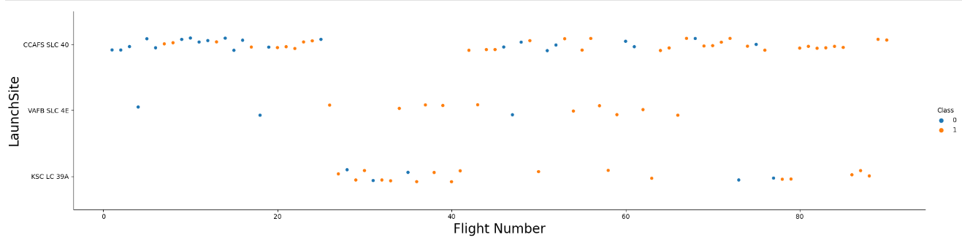
EDA with Data Visualization
I used both scatter and bar plots to analyze relations between success & failure and the rocket’s features, such as:
Source: https://github.com/Kholstein/CourseraIBMCapstone
Payload Mass & Flight Number
Launch Site & Flight Number
Launch Site & Payload Mass
Orbit Type & Flight Number
Payload & Orbit Type

Slide 10
EDA with SQL
I used the following SQL Queries during the project:
Source: https://github.com/Kholstein/CourseraIBMCapstone
5 Names of unique launch sites used by SpaceX
First 5 Launch sites under the CCA
The total payload mass carried by NASA launchers
Avg. Payload mass carried by F9 v1.1
Date of first successful landing of F9
Names of boosters that successfully carried drone shipments of payload masses between 4000 and 6000 kg
Total success & failure ratio
How many boosters carried the maximum amt of payload mass
Failed landings in drone shipment, and their specifics such as: booster version and launch pads in 2015
Successful/Failure ratio of rockets in the dates between 06/04/2010 – 03/20/2020

Slide 11
Build an Interactive Map with Folium
I made interactive Folium maps of the launch sites used, using markers, circles, lines & marker clusters
Markers indicate launch points
Circles highlight areas of importance such as the NASA Johnson Space Center
Market Clusters highlight area of an instance occurring multiple times at once, such as launches at a launch site.
Lines are used to measure distance between two points, such as the NASA Johnson Space Center & nearby railroads/coasts.
Source: https://github.com/Kholstein/CourseraIBMCapstone

Slide 12
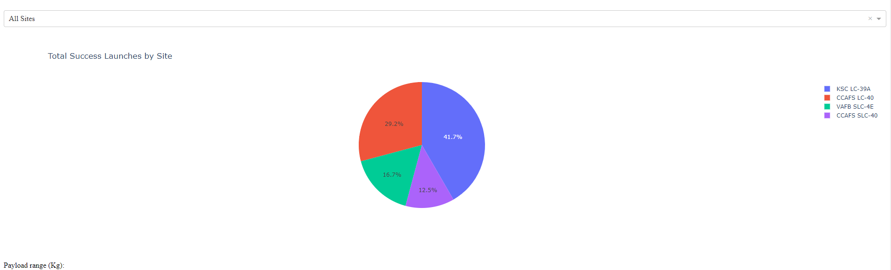
Build a Dashboard with Plotly Dash
I used Percentage graphs & Range graphs to visualize the relation of Payloads & the respective launch sites, helping to ID the best place to launch certain payloads.
Source: https://github.com/Kholstein/CourseraIBMCapstone, Image is a Plotly Dashboard Chart

Slide 13
Predictive Analysis (Classification)
Four classification models were compared: logistic regression, support vector In this method:
First I Prepped the data and standardized it all into a single cohesive thing.
Second I Tested the data rigorously with multiple combinations of their parameters.
Finally I looked at the results of the output of each Classification model.
Source: https://github.com/Kholstein/CourseraIBMCapstone

Slide 14
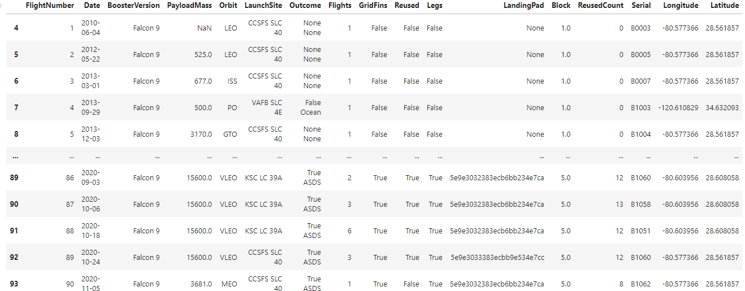
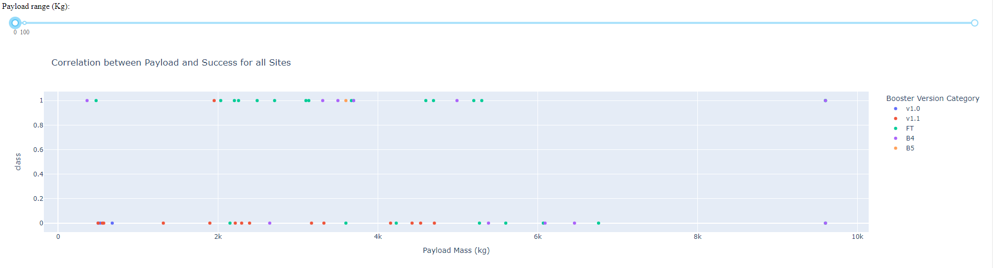
Results
• Space X uses 4 different launch sites
• The average payload of F9 v1.1 booster is 2,928 kg
• The first success landing outcome happened in 2015 five years after the first launch
• Almost 100% of missions were successful
• Two booster versions failed at landing in drone ships in 2015: F9 v1.1 B1012 and F9 v1.1 B1015
These were the results of my labor:

Slide 15

Section 2

Slide 16
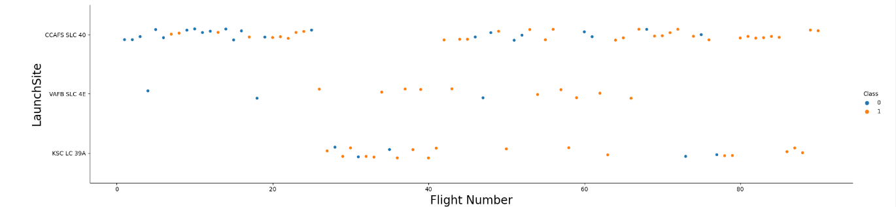
Flight Number vs. Launch Site Scatter Plot
According to the scatter plot, it’s possible to verify that the best launch site nowadays is CCAF5 SLC 40, where most of recent launches were successful.
KSC LC 39A is overall the most successful one of them all from the time frame shown.
VAFB SLC 4E has the least amount of tests and has not been tested for a while.

Slide 17
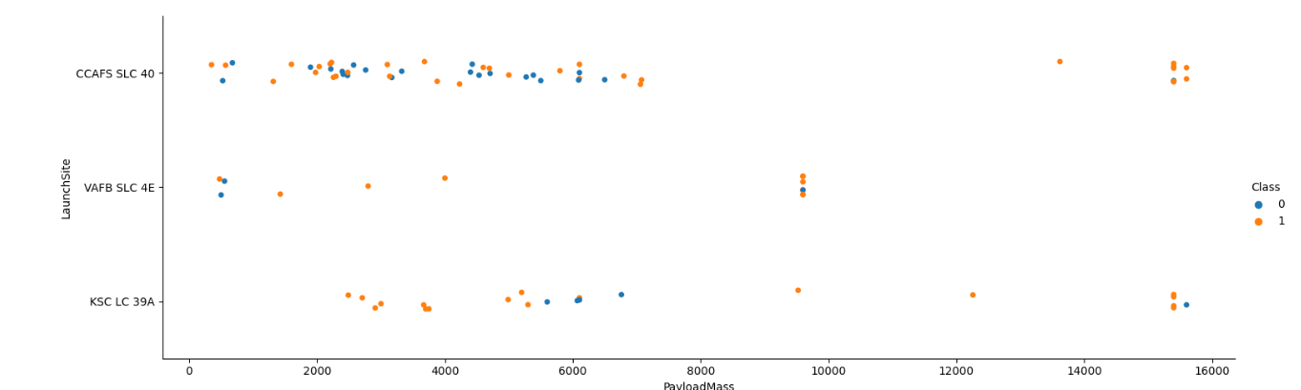
Payload vs. Launch Site Scatter Plot
Payloads over 12,000kg seems to be possible only on CCAFS SLC 40 and KSC LC 39A launch sites.
Payloads near 4,000 and 8,000 kg seem to mostly be unsuccessful while payloads over 8,000kg seem to be mostly successful while >4,000 kg is a mixed bag.

Slide 18
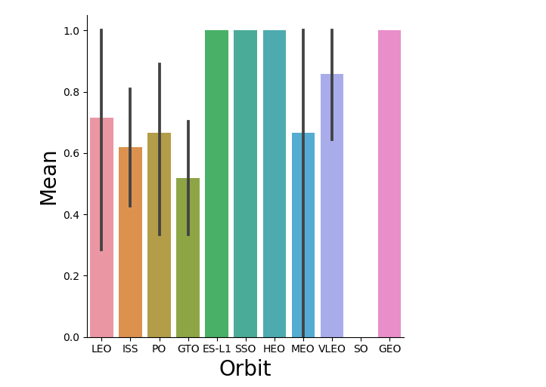
Success Rate vs. Orbit Type Bar Chart
SSO, HEO, and ES-L1 have highest average success rates.
The black lines represent the outliers.
SO Appears to not be tested.

Slide 19
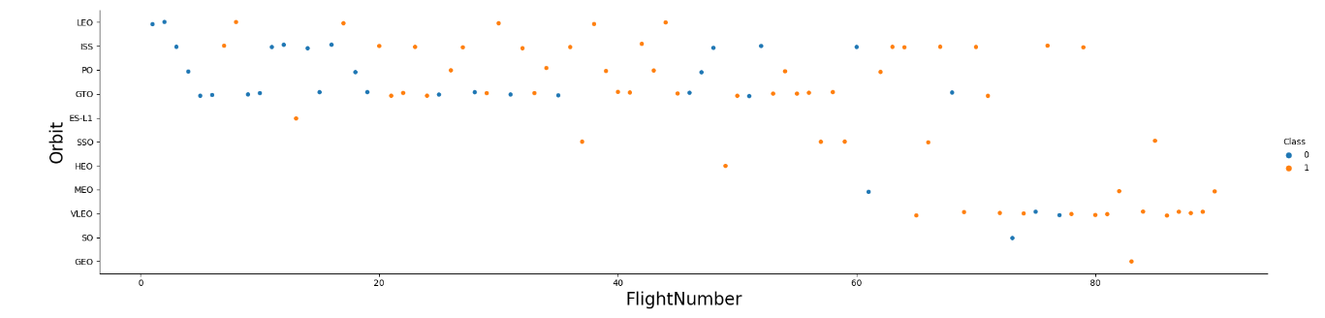
Flight Number vs. Orbit Type Scatter Plot
Initial orbits were usually unsuccessful, SSO has the best success rate of all orbits.
GEO and HEO Orbits have been tested only once
ISS orbit has been the most rigorously tested, with a 62% success rate

Slide 20
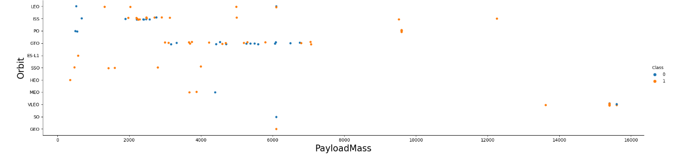
Payload vs. Orbit Type scatter plot
LEO, ISS and PO have low successful launches with lighter payloads.
MEO, VLEO, SO & GEO need further tests to give accurate results
ISS & GTO have the most rigorous testing and has the best success rate of the two.

Slide 21
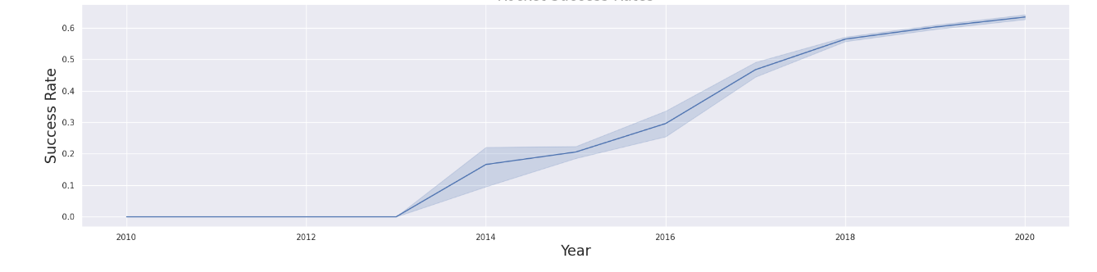
Launch Success Yearly Trend
Launches have steadily gotten more successful with no downturn.
Rocket launches were started in 2013 and are plateauing near 2020

Slide 22
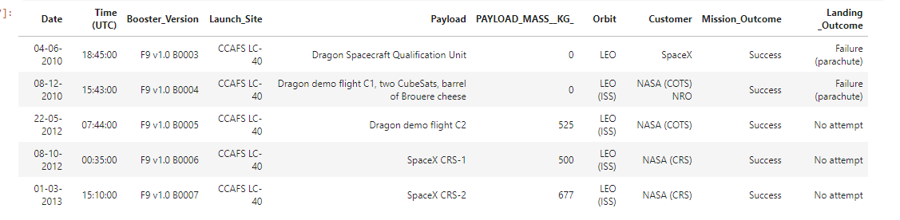
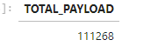
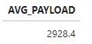
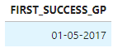
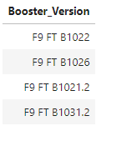
Other Neat Tidbits
Launch Site names are: CCFAS LC-40, CCFAS SLC-40, KSC LC-39A, VAFB LC-39A
5 Records that start with ‘CCA’:
Total Payload of NASA boosters:
Avg payload mass carried by booster version F9 v1.1:
Date of first successful Landing:
Names of boosters which have successfully landed on drone ship and had payload mass greater than 4000 but less than 6000:

Slide 23
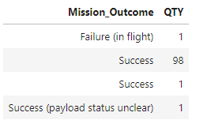
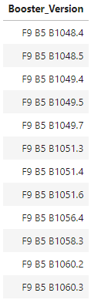
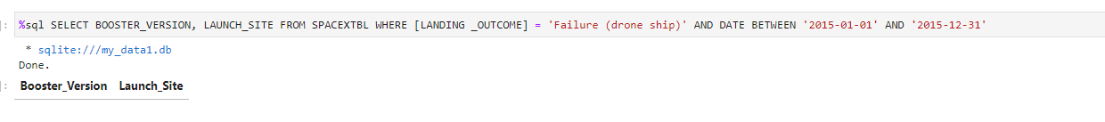
Other Neat Tidbits pt. 2
Total number of successful and failure mission outcomes:
Boosters which have carried the maximum payload mass:
Boosters which have successfully landed on drone ship
and had payload mass greater than
4000 but less than 6000

Slide 24
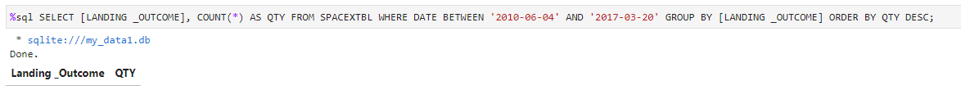
Other Neat Tidbits pt. 3
Landing outcomes (such as Failure (drone ship) or Success (ground pad)) between the date 2010-06-04 and 2017-03-20, in descending order

Slide 25

Section 3

Slide 26
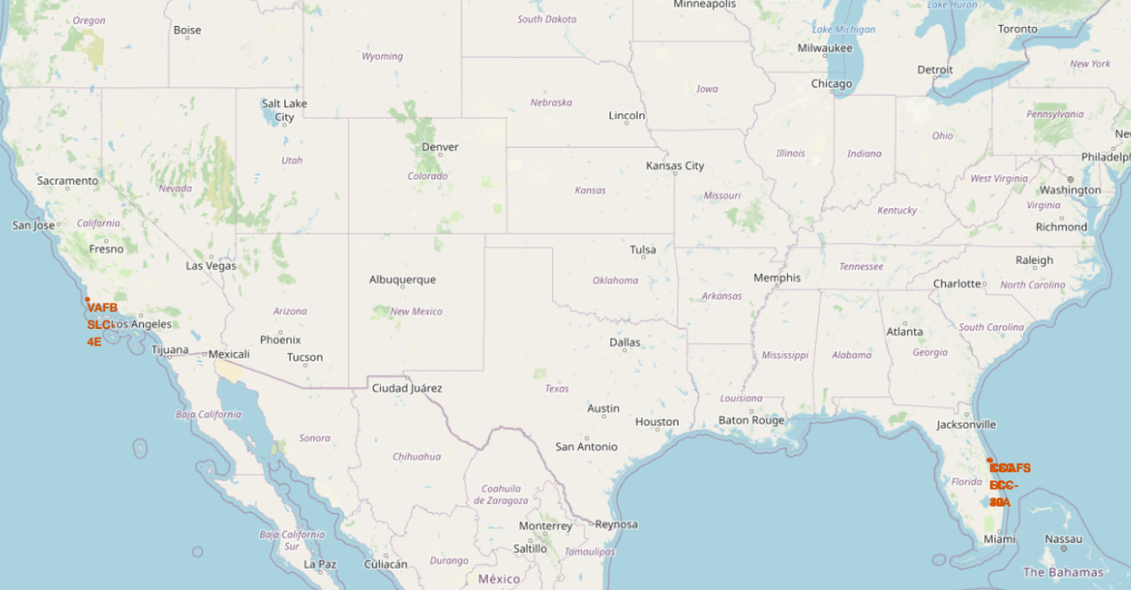
All launch sites
Launch sites are all on the opposite sides of the country to avoid any serious rocket-on-rocket catastrophe possibly, and nearby seas to avoid big impact craters.

Slide 27
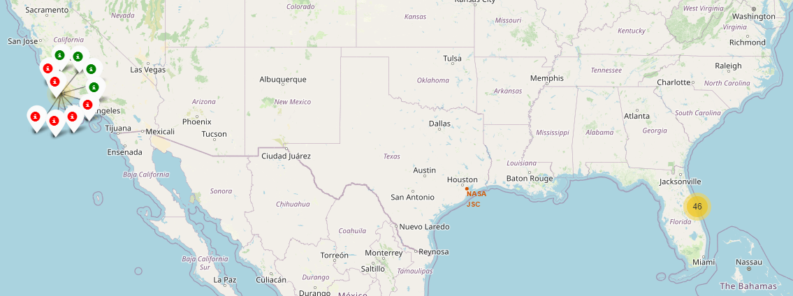
Launch Outcomes by Site
This is an example of the VAFB SLC-4E launch site outcomes, green is successful, red is unsuccessful.

Slide 28
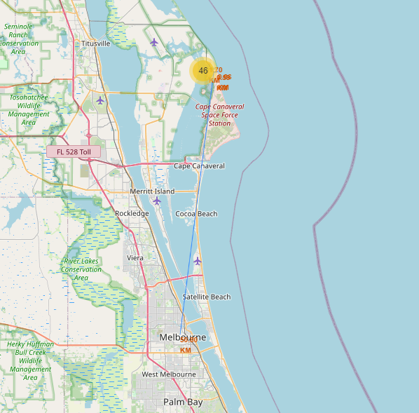
Logistics and Safety
Cape Carnival Space station is a bit too close to a densely populated City, Melbourne.

Slide 29

Section 4

Slide 30
Success Count for All Sites
KSC-LC39A has the most successful launches, so it should be replicated to the CCAFS SLC-40 and VAFB SLC-4E sites.

Slide 31
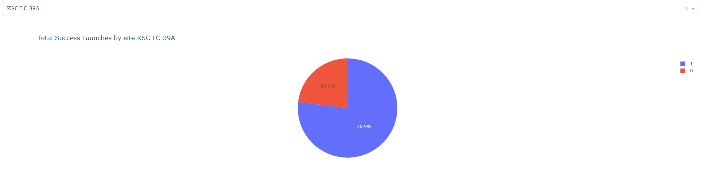
Highest launch success
LC-39A has a very high success rate compared to the others, where roughly up to 40% can be failures.

Slide 32
Scatter Plot
Payloads under 6,000kg and FT boosters are the most successful combination, and there is not enough data over 7k to give valid input for these tests.

Slide 33

Section 5

Slide 34
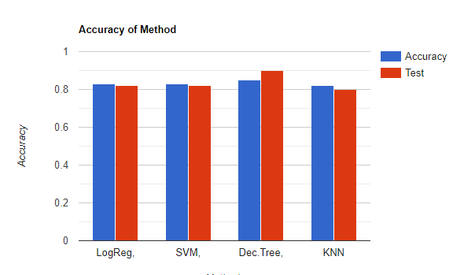
Classification Accuracy
The model with the highest classification accuracy is Decision Tree Classifier, which is 87%.
The model with the lowest classification accuracy is SVM, which is 83%

Slide 35
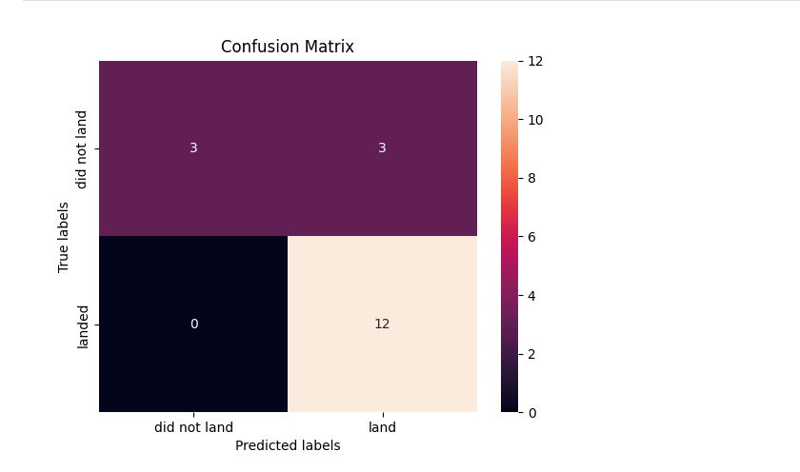
Confusion Matrix
Confusion matrix of Decision Tree Classifier proves its accuracy by showing the big numbers of true positive and true negative compared to the false ones.

Slide 36
Conclusions
The best launch site is KSC LC-39A;
Launches above 7,000kg are less likely to fail.
Successful landing outcomes seem to improve over time with technological advancements, meaning they’re learning from successful launches and are using those results.
Decision Tree Classifier can be used to predict successful landings and increase profits.

Slide 37


